Slide 1
Department
Personas / Workstyles
NH
We me us
Adjacencies : infra, green building, compliance, distraction, access (public vs. private vs. hub vs. seclusion)
3 typical floors
Unique floors
Cultural - pantry entry / meetings cluster BC vs meeting distributed
New and renovation

Slide 2
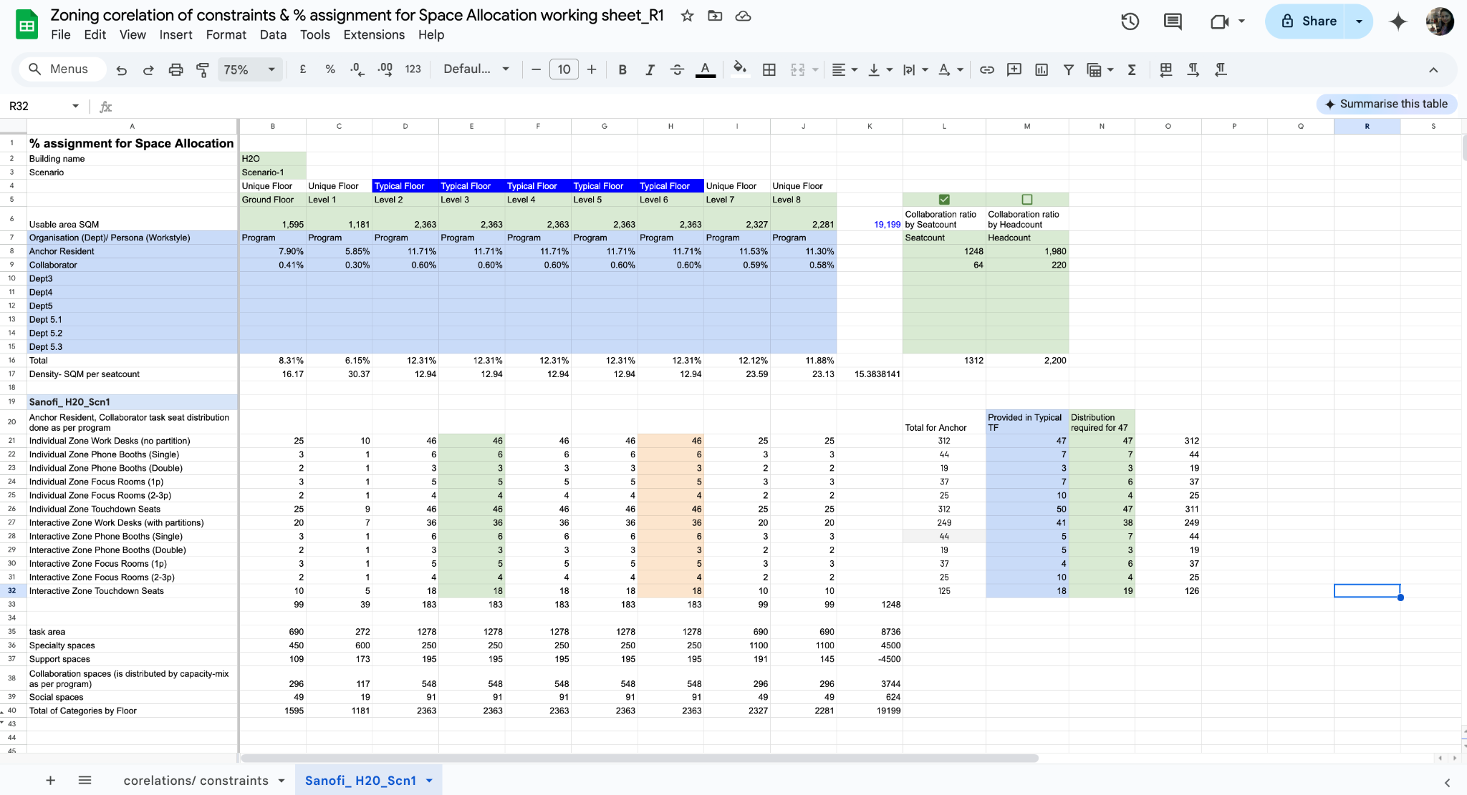
Stacking Hypothesis
Divide the program of spaces into the following categories
ME: WE: Team US + Support Spaces + floor amenity spaces
Welcome spaces, external-public access spaces
Speciality + site support + all marquee spaces (like you do in retail, marquee brands by floor)
Identify a Typical floor
Define the seatcount that can be achieved in the typical floor by dividing floor USF from target density. To get the HC per floor divide by (1-mobility) or anticipated daily attendance
Assign these SC or HC as a whole or split by departments as per need. All department assignment is a complex relationship of compliance adjacency and ‘split across floors’ allowance
Run a micro-program (for this SC or HC) with all linked distribution for ME: WE: Team US + Support Spaces + floor amenity spaces for the identified typical floor. If the floor is not fully consumed increase the space-mix retaining the same distribution relationship. This should give you a new SC or HC numbers that is a fit for the floor. Lock this assignment.
Assign the above output to each level of the typical floors, retain the departmental space-mix distribution when they are unique to each department.
Next calculate residual ME: WE: Team US spaces + Support Spaces + floor amenity spaces, keep in temp-vault
Assign welcome spaces, external-public access spaces to one floor. If the floor is not fully consumed,
Check 1 - do you have any speciality + site support + all other marquee spaces, if yes then assign this to the floor. If not then assign the spaces in the temp-vault before you proceed to the remaining floors
Check 2 - if the floor still has residual spaces then assign spaces in the temp-vault
Notes:
https://docs.google.com/spreadsheets/d/1moJMaYEg-K0yoQLdbzlWXpNAH51JwlLfqt2I-WLBp6g/edit?gid=637500727#gid=637500727

Slide 3
Stacking Hypothesis
When there still are multiple floors remaining, assign the remaining specialty spaces, site amenity spaces, to floors as how they best fit these areas,
in one scenario distribute the marquee spaces to make destination floors, then assign the spaces in vault as per their relative distribution (which is derived from SC or HC relationship)
In the 2nd scenario club all the spaces to exhaust the floors one by one, then assign the spaces in vault as per their relative distribution (which is derived from SC or HC relationship)
General Rule - Bundle residual spaces that are in excess of 1/10th of the floor USF into one floor
Override Rule 1: In any of the above process if the allocated spaces are slightly higher than the floor USF and when others rules of adjacency do not allow splitting of SC or HC to other floors then marginally reduce the circulation % or the size of any support spaces to accommodate requirements within the selected floor for available floor USF. In this instance the Floor Circulation adjusted in the stacking plan by levels will override the circulation for all departments or % of seats in this floor. This needs to connect back and revise the program USF.
Override Rule 2: Once you have run all rules of stacked assignment and you still have certain unallocated blocks, you need to review the locked floors to shift certain spaces to achieve 100% allocation. Run override rule-1 where required. But the variation of the micro-program to the actual program cannot exceed the variation allowance defined in the config/ playbook.
Define a rule to allow stacking of certain space-types in the same position across all the floors.
Define a stacking justification rule (left - center- right) for the user to choose visualisation of reduced floor USF stack
Notes:
https://docs.google.com/spreadsheets/d/1moJMaYEg-K0yoQLdbzlWXpNAH51JwlLfqt2I-WLBp6g/edit?gid=637500727#gid=637500727

Slide 4
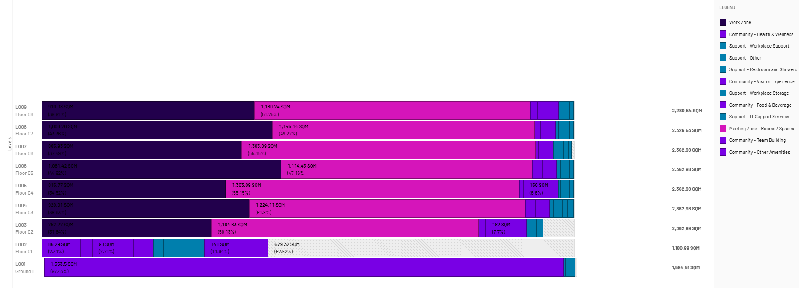
Cafetaria on the ground floor for the ease of services
Amenities common to the organisation on lower floor
Client center dedicated on one floor

Slide 5
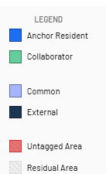
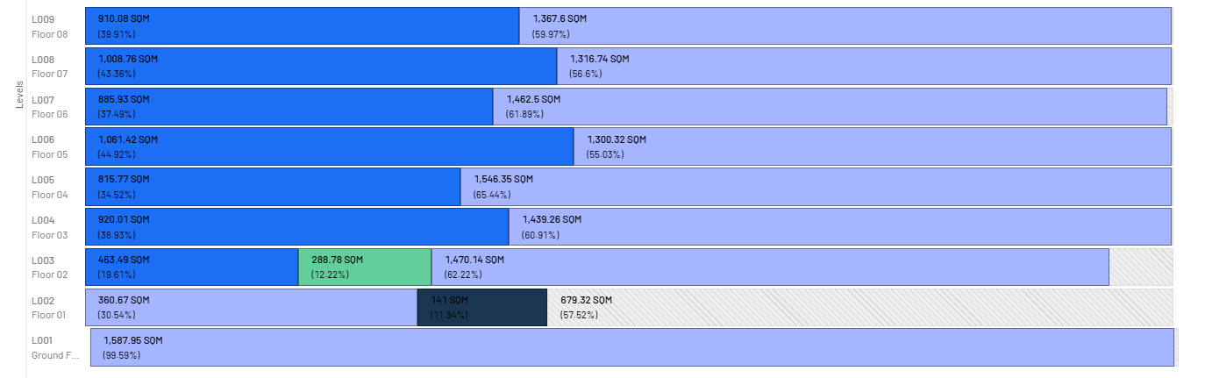
Stacking

Slide 6
Zoning Hypothesis
Create Floor Anatomy Map
Zoning step-1, step-2, step-3
Define correlation and constraints matrix
Define priorities
Define proximities
Define placements

Slide 7
Floor Anatomy map Typical Work floor - Building constraints
Periphery
Natural Gathering zones
Periphery
Natural gathering Zone
Natural gathering Zone
Natural gathering Zone
Main Entry
Primary Entry
T
L
L
T
st
Vertical movement
Fire Egress
Periphery
L
L
Periphery
Fire Egress
st
L
Primary Entry
L
Natural gathering Zone
Natural gathering Zone
Natural gathering Zone
ME - Seclusion zone
Periphery

Slide 8
Zoning step 1 - zoning around Building constraints + priority 1 levers
Multiple Outputs
Periphery
Hub/ Community/ Public zone -opt1
Populate Priority 1 for ME Seclusion Zone
Populate Priority 1 for Hub/ Community/ Public Zone
Collaboration Zone
Natural gathering Zone
Natural gathering Zone
Natural gathering Zone
Populate Priority 1 for Collaboration Zone
Primary Entry
T
L
L
T
st
Fire Egress
Periphery
L
L
Periphery
Fire Egress
st
L
Primary Entry
L
Natural gathering Zone
Hub/ Community/ Public zone -opt2
Natural gathering Zone
Natural gathering Zone
Collaboration
Zone
ME - Seclusion zone
Periphery

Slide 9
Zoning step 2 - zoning around Building constraints + priority 2 levers
Multiple Outputs
Periphery
Hub/ Community/ Public zone -opt1
Populate Priority 2 for ME
ME
Populate Priority 2 for WE
Team social
Collaboration Zone
Natural gathering Zone
Natural gathering Zone
Team social
Natural gathering Zone
Populate Priority 2 for Team Social
Primary Entry
T
L
L
T
st
Fire Egress
Periphery
L
L
Periphery
Fire Egress
st
L
Primary Entry
L
Natural gathering Zone
Hub/ Community/ Public zone -opt2
Natural gathering Zone
Natural gathering Zone
Team social
Team social
Collaboration
Zone
ME - Seclusion zone
Periphery

Slide 10
Zoning step 3 - fine tuning and scoring the outputs
Periphery
Hub/ Community/ Public zone -opt1
Populate Priority 1 for Seclusion Zone
ME
Populate Priority 1 for Hub/ Public Zone
Team social
Collaboration Zone
Natural gathering Zone
Natural gathering Zone
Team social
Natural gathering Zone
Populate Priority 1 for Hub/ Public Zone
Primary Entry
T
L
L
T
st
Fire Egress
Periphery
L
L
Periphery
Fire Egress
st
L
Primary Entry
L
Natural gathering Zone
Hub/ Community/ Public zone -opt2
Natural gathering Zone
Natural gathering Zone
Team social
Team social
Collaboration
Zone
ME - Seclusion zone
Periphery

Slide 11
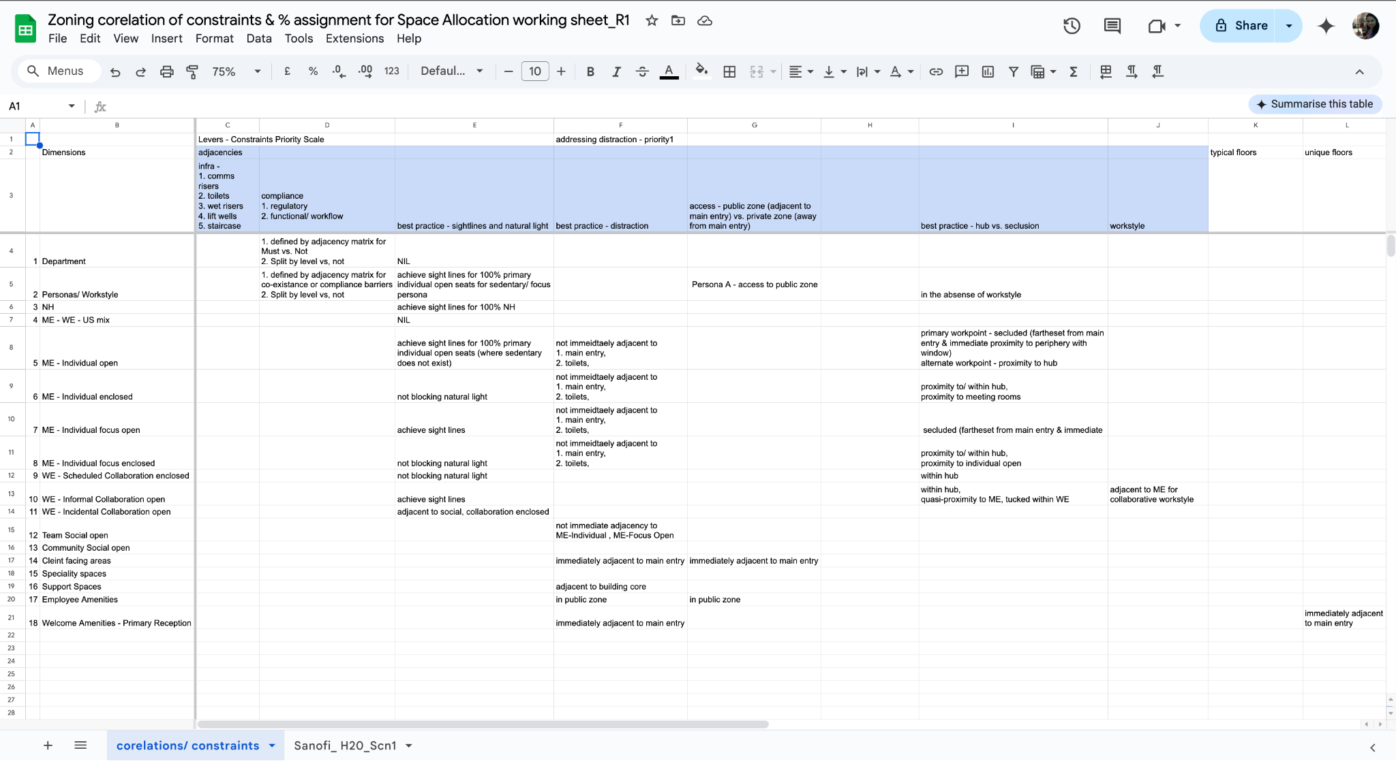
Notes:
Tab 1: - https://docs.google.com/spreadsheets/d/1moJMaYEg-K0yoQLdbzlWXpNAH51JwlLfqt2I-WLBp6g/edit?gid=319045530#gid=319045530

Slide 12
Zoning Samples customer 1

Slide 13
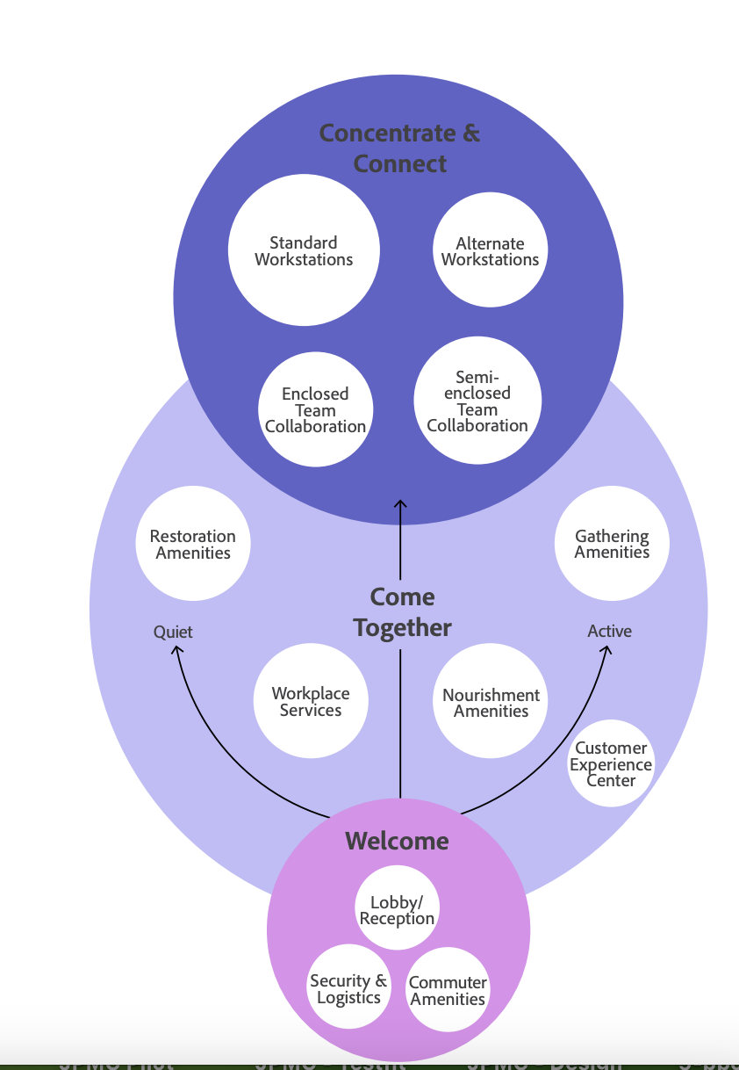

Slide 14
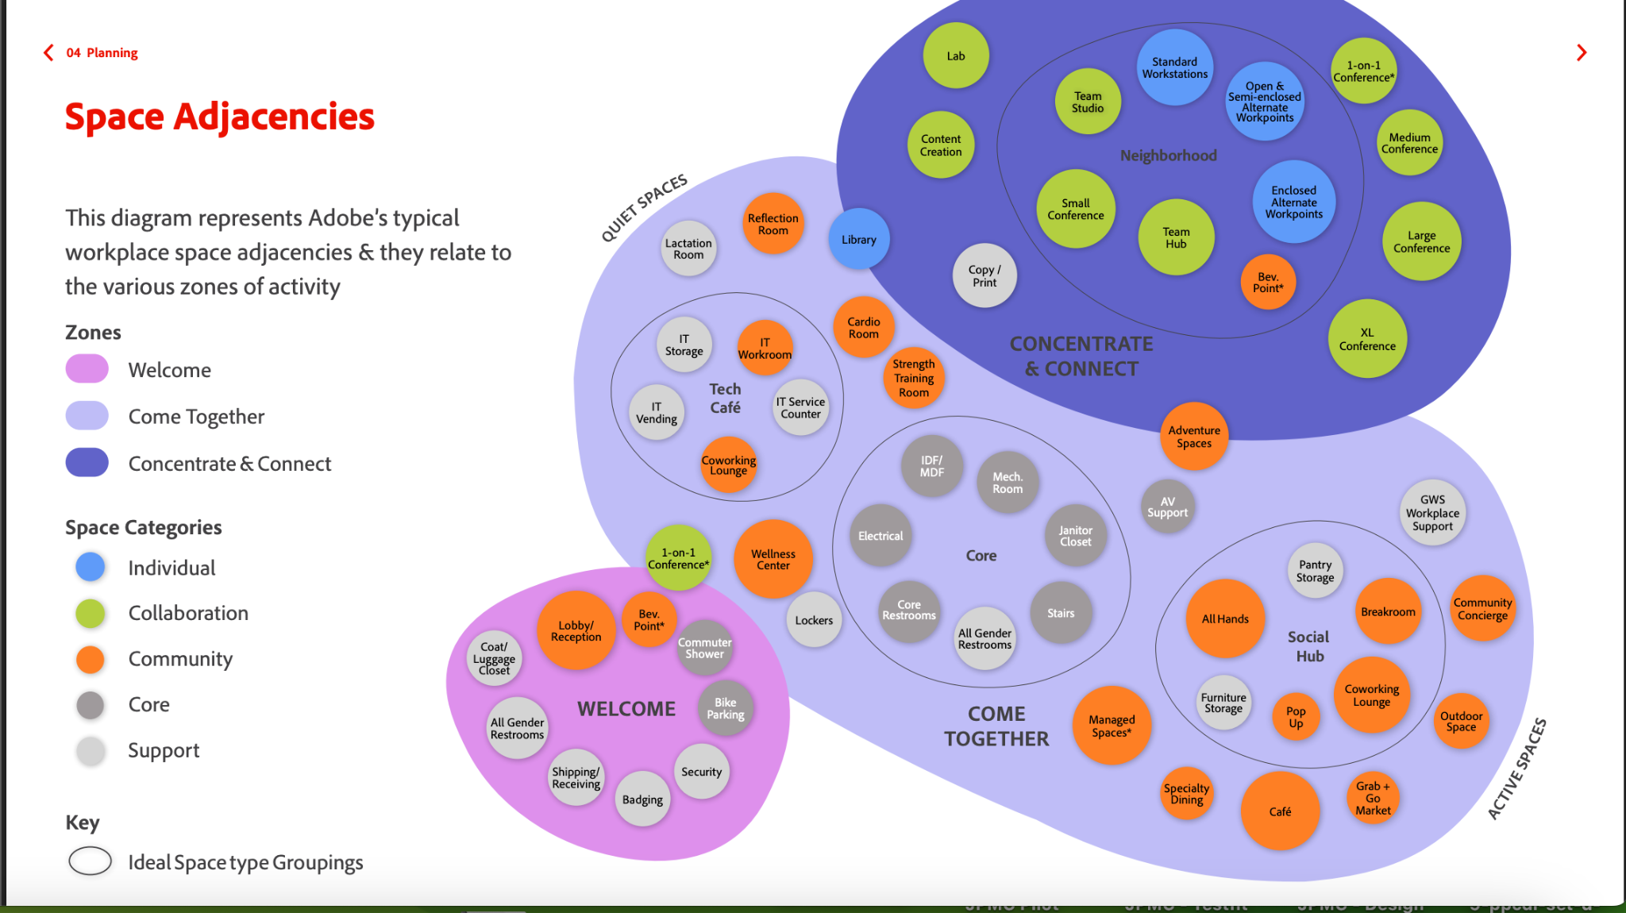

Slide 15
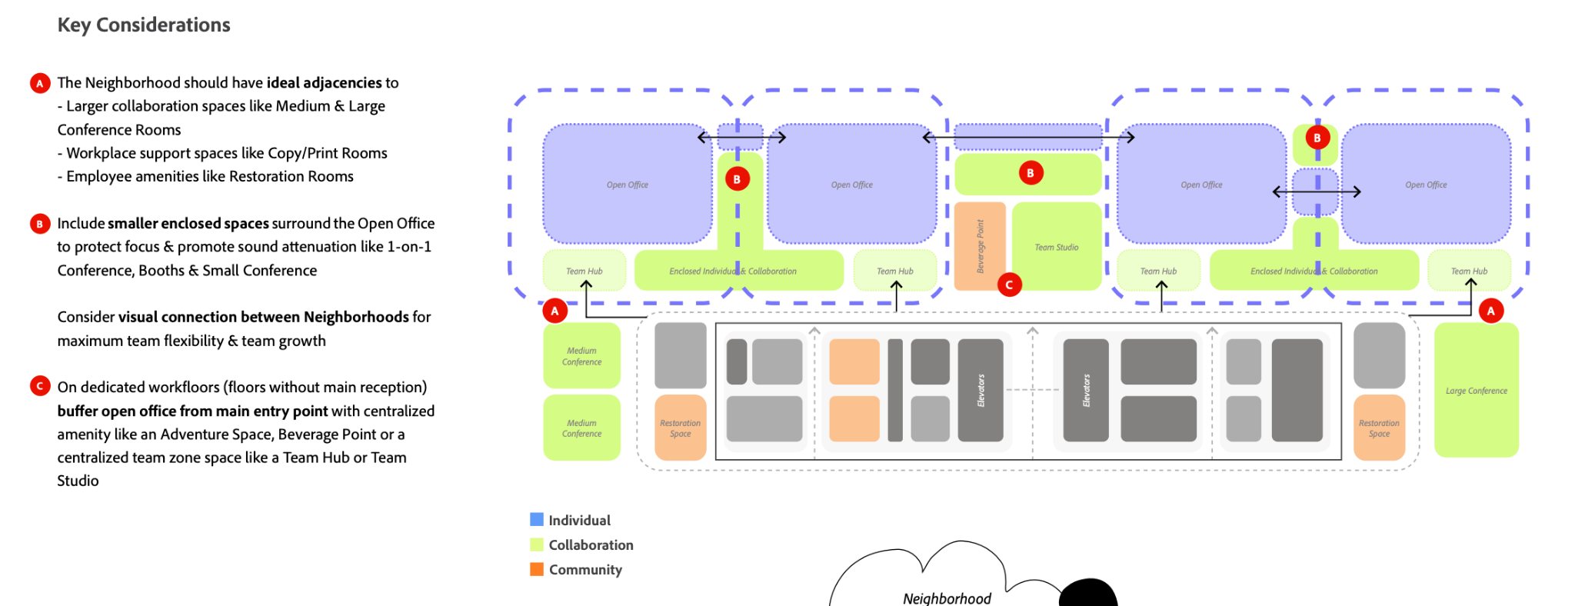

Slide 16
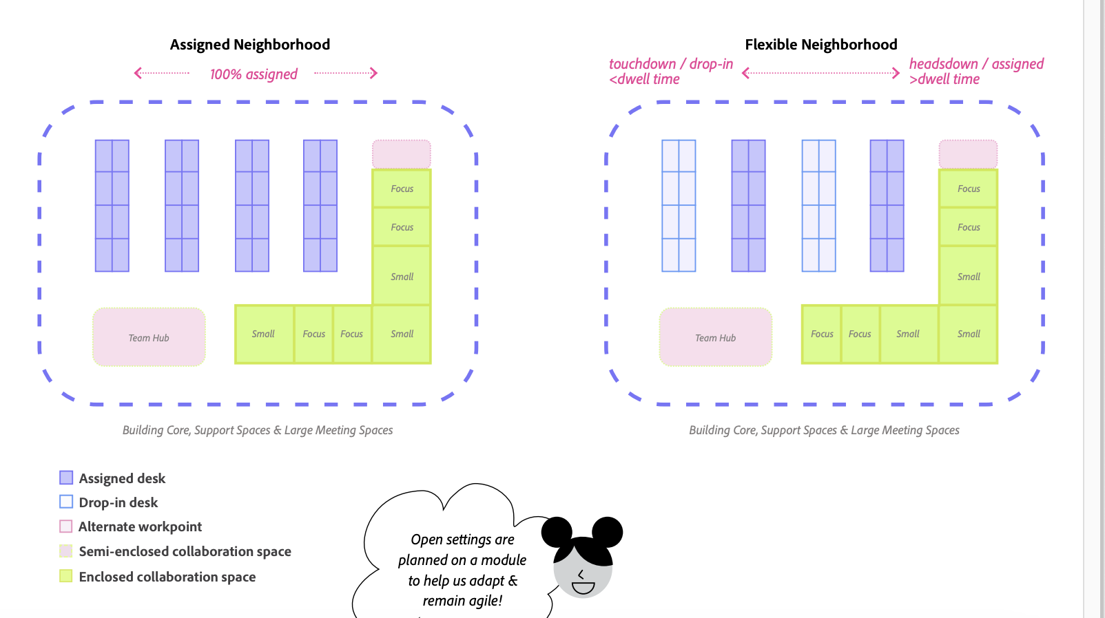

Slide 17
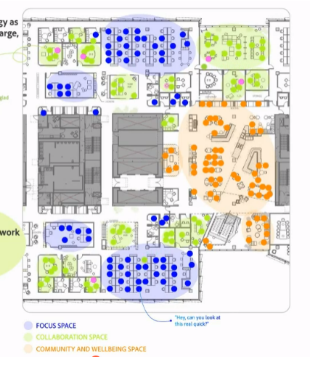

Slide 18
Zoning customer 2

Slide 19
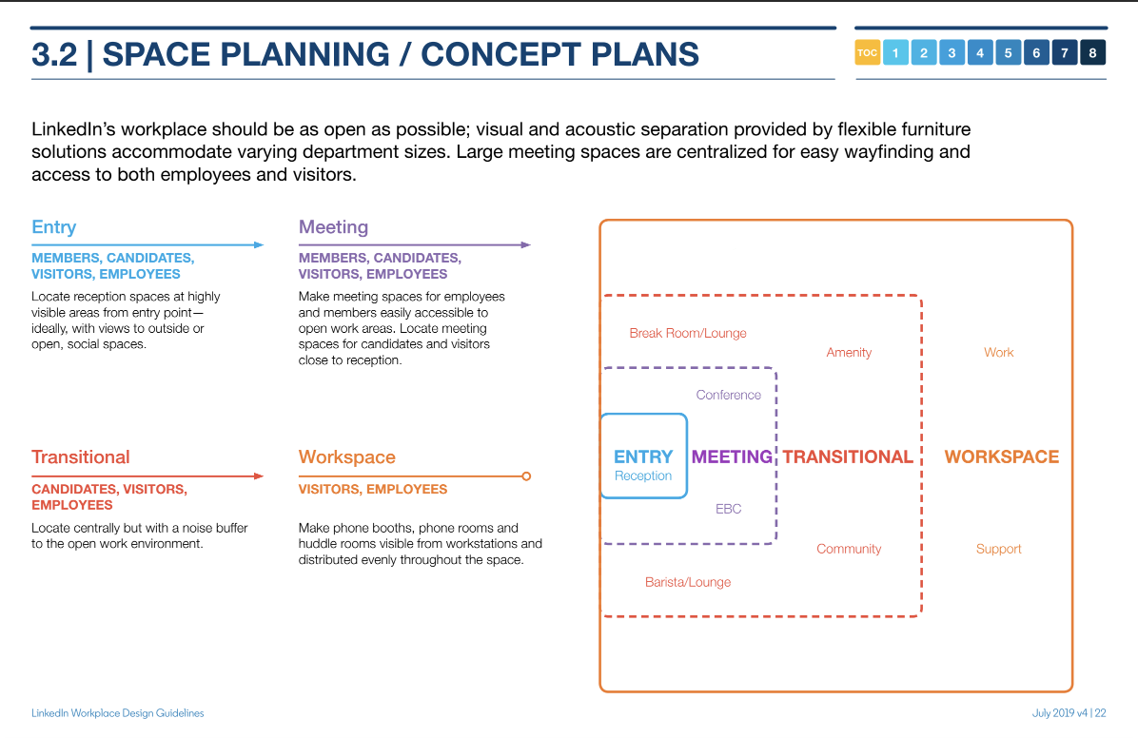
Customer 2

Slide 20
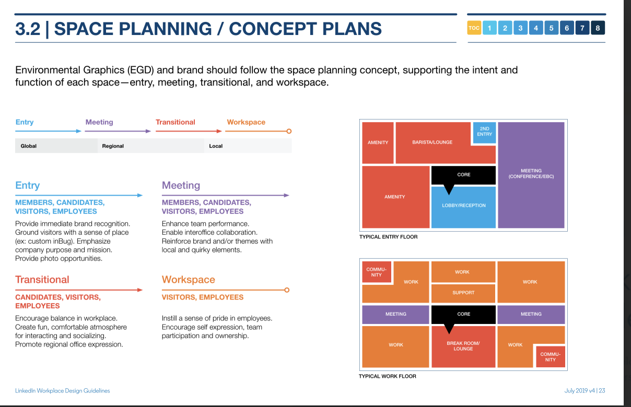
Customer 2

Slide 21
Customer 2

Slide 22
Zoning customer 3

Slide 23
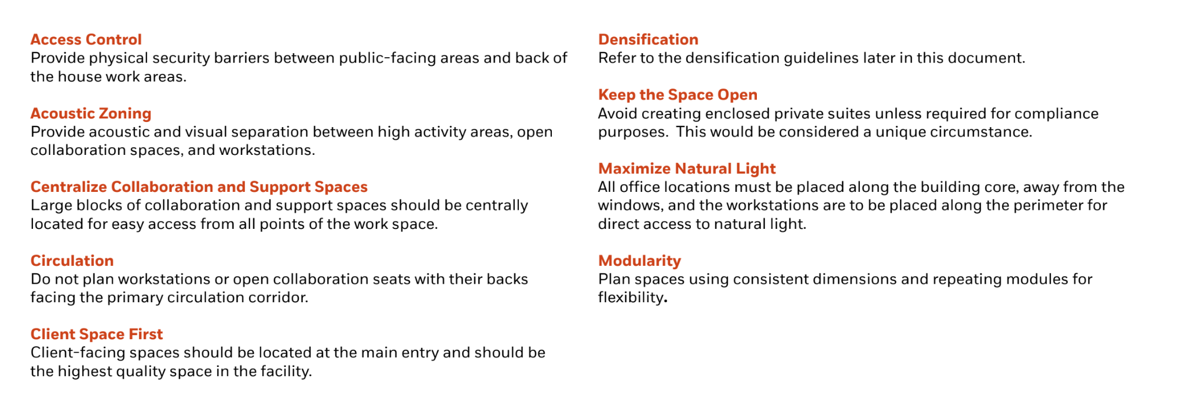
Customer 5

Slide 24
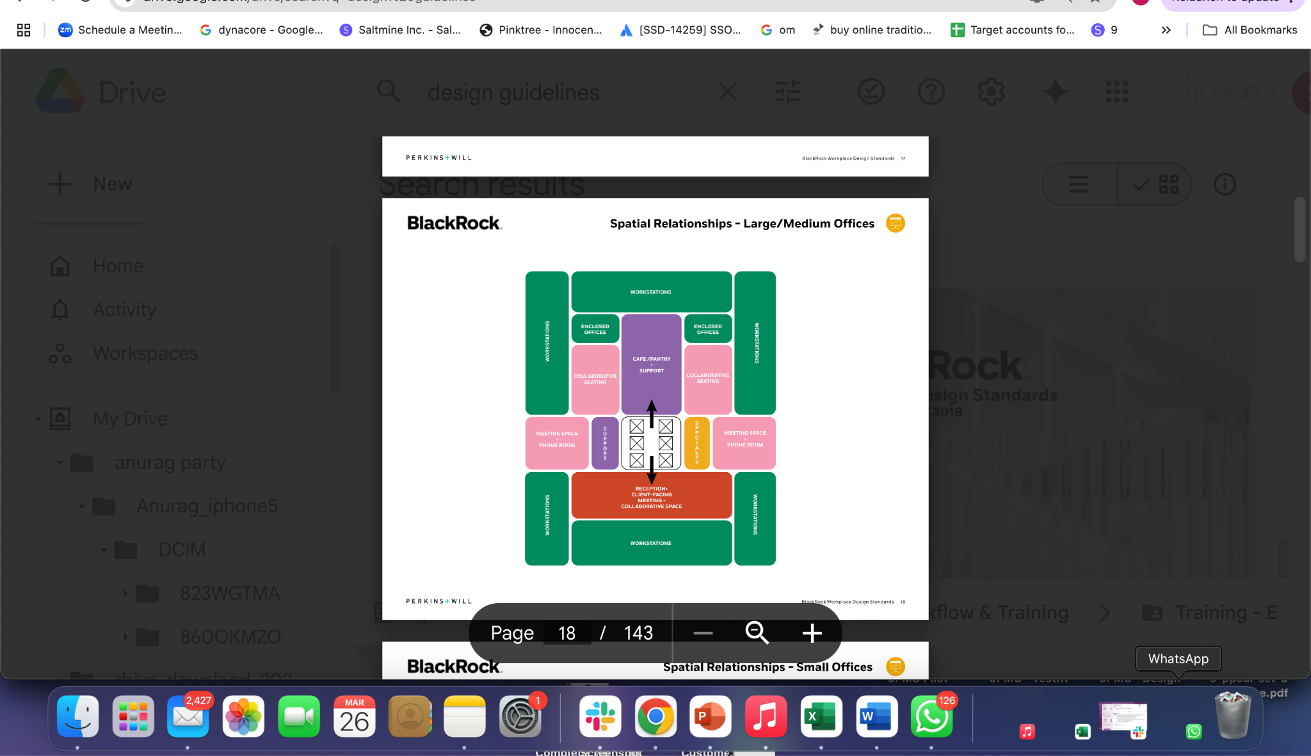

Slide 25
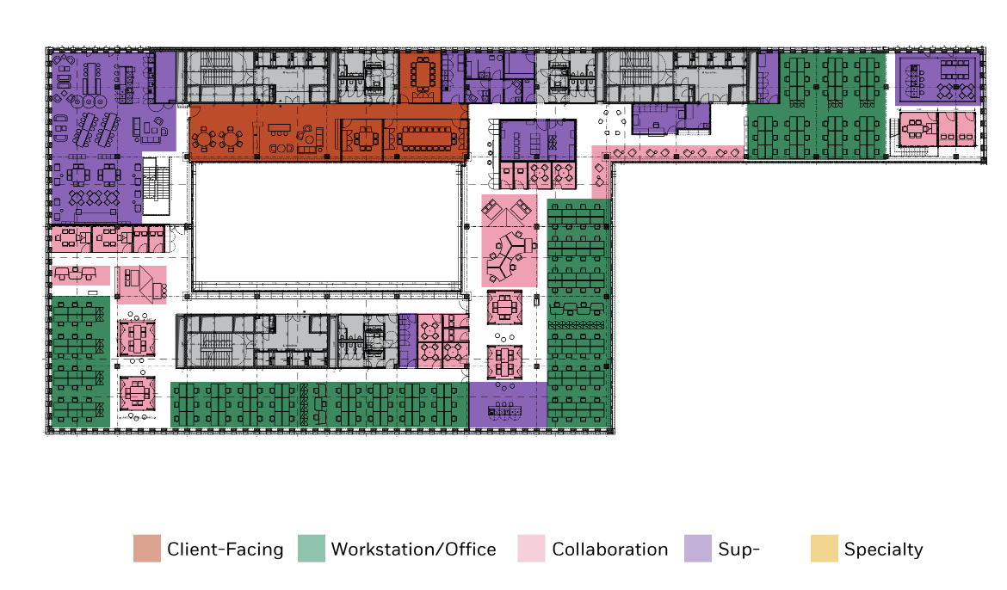
Customer 5

Slide 26
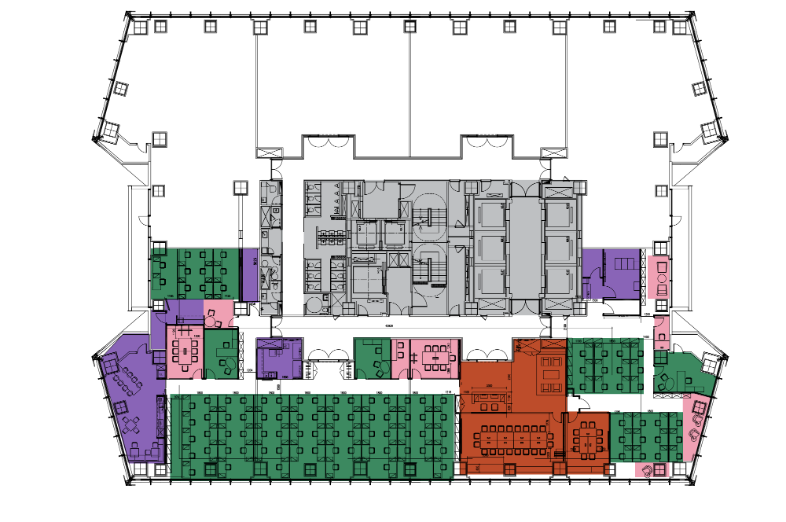

Slide 28
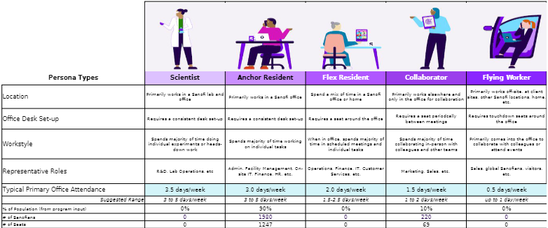
Stacking options - customer 1
Notes:
Stacking by dept
stacking by NH
stacking by space types

Slide 29
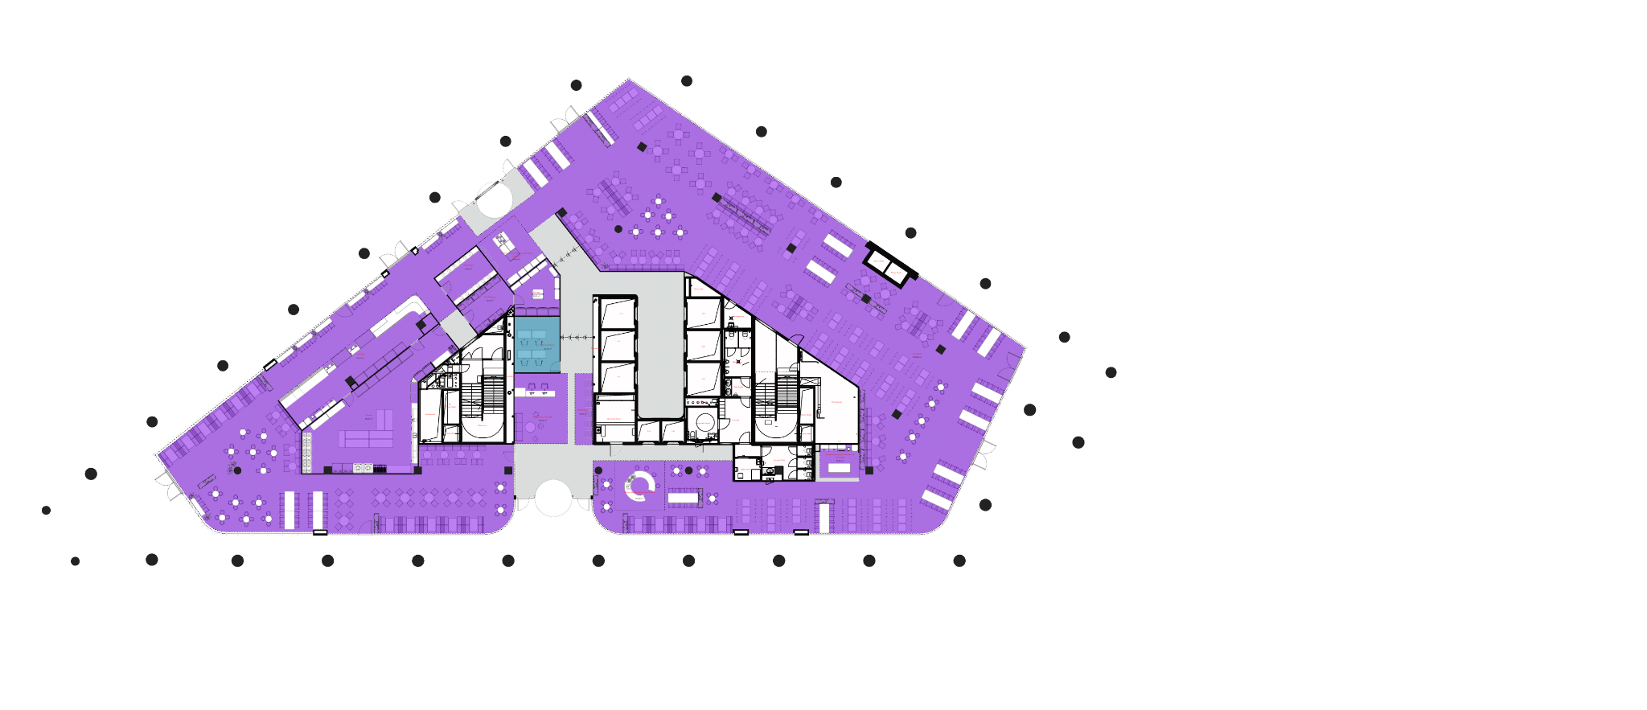
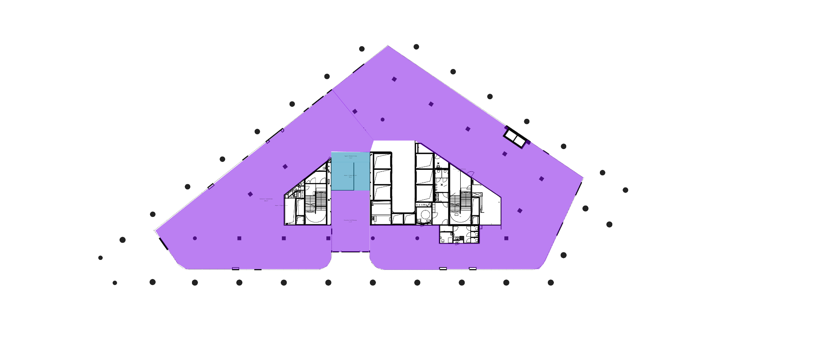
Zoning options - customer 1 Ground floor
LINK
Notes:
Stacking by dept
stacking by NH
stacking by space types

Slide 30
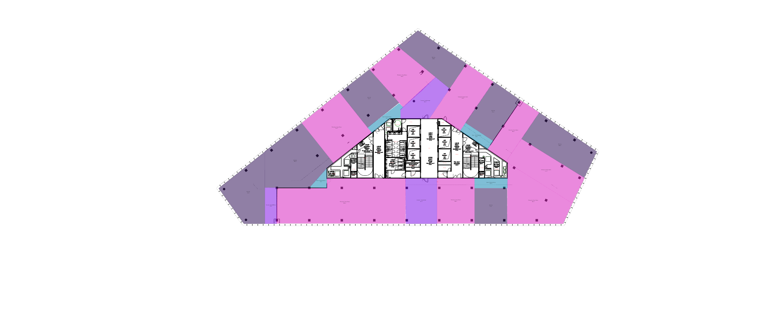
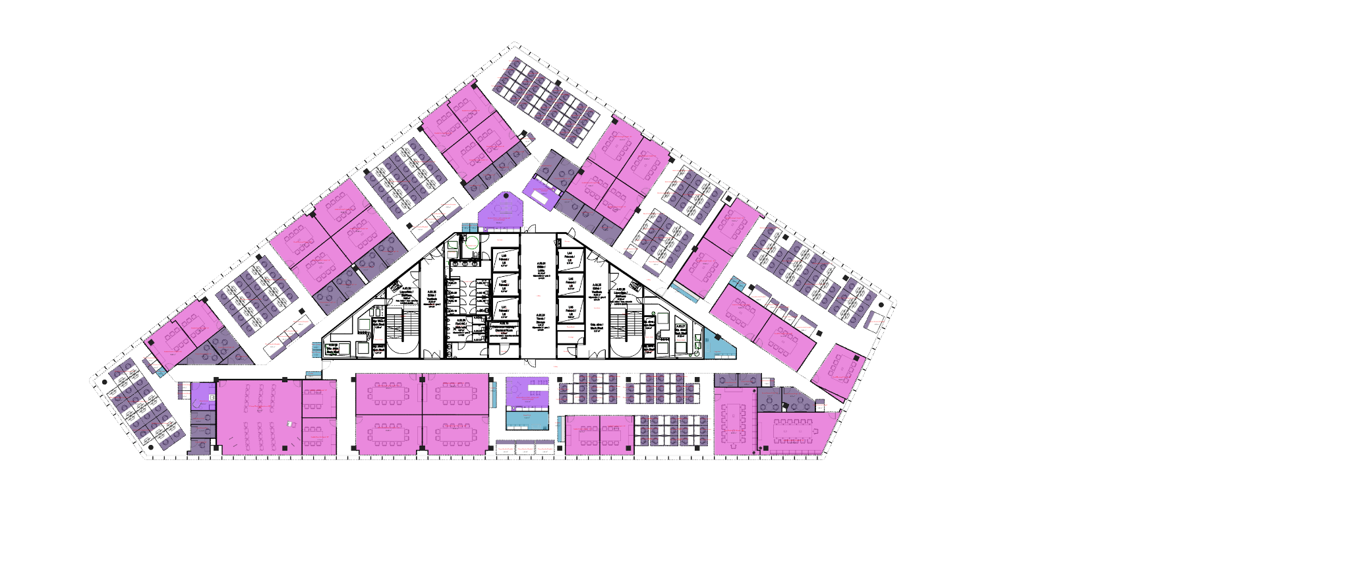
Zoning - customer 1 Typical floor
LINK

Slide 31
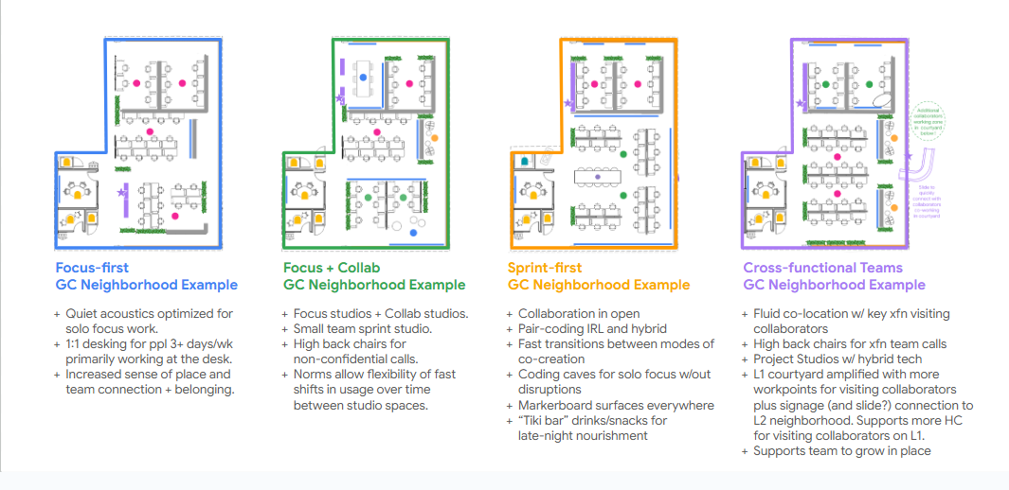
Stacking options - 1 - new NH - customer 2

Slide 32
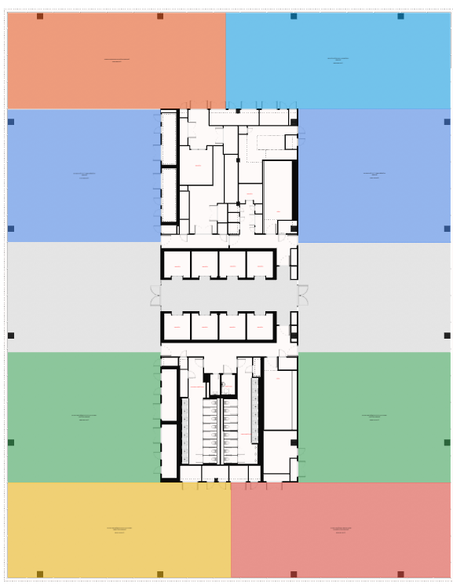
Stacking options - 1

Slide 33
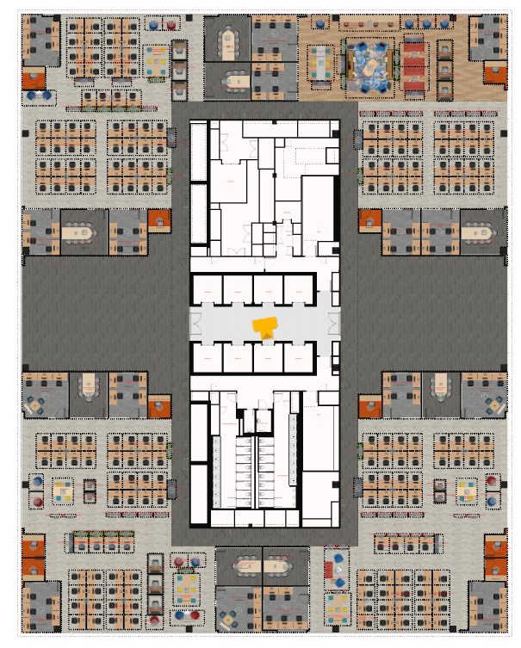

Slide 35
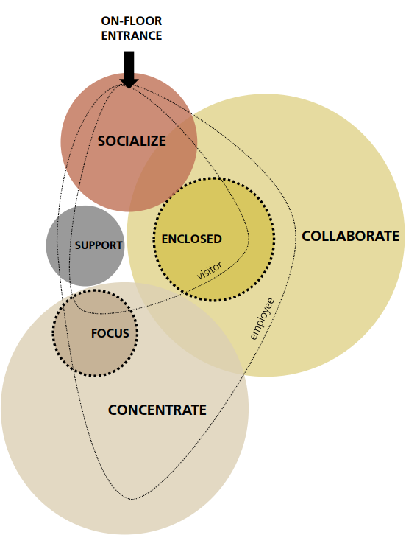
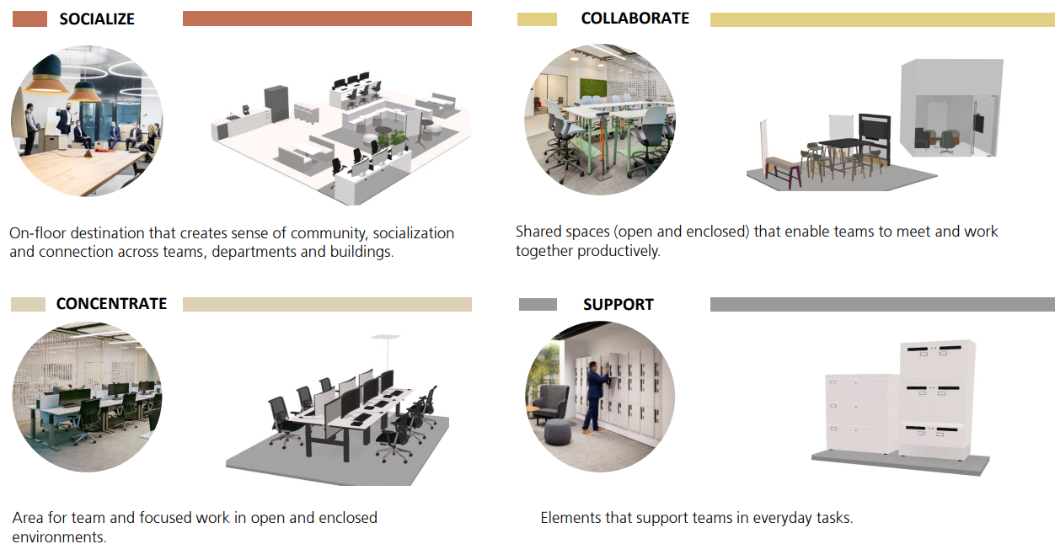
Customer 3

Slide 36
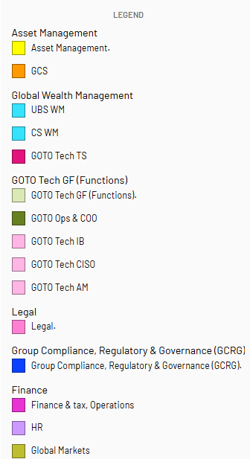
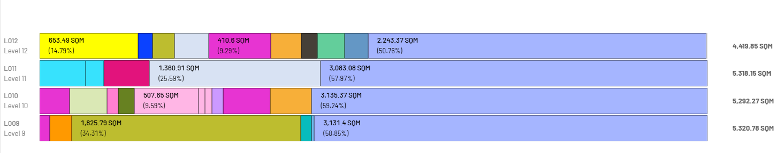
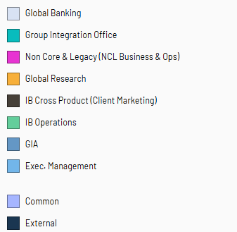
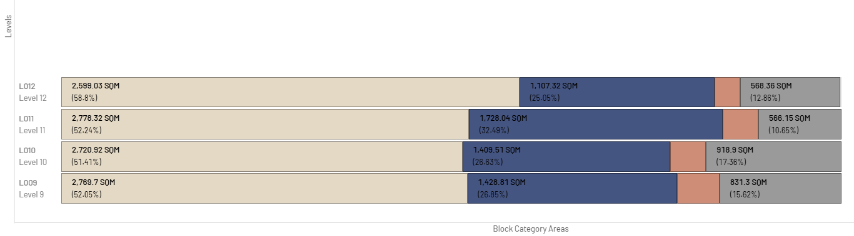
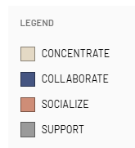
stacking

Slide 37
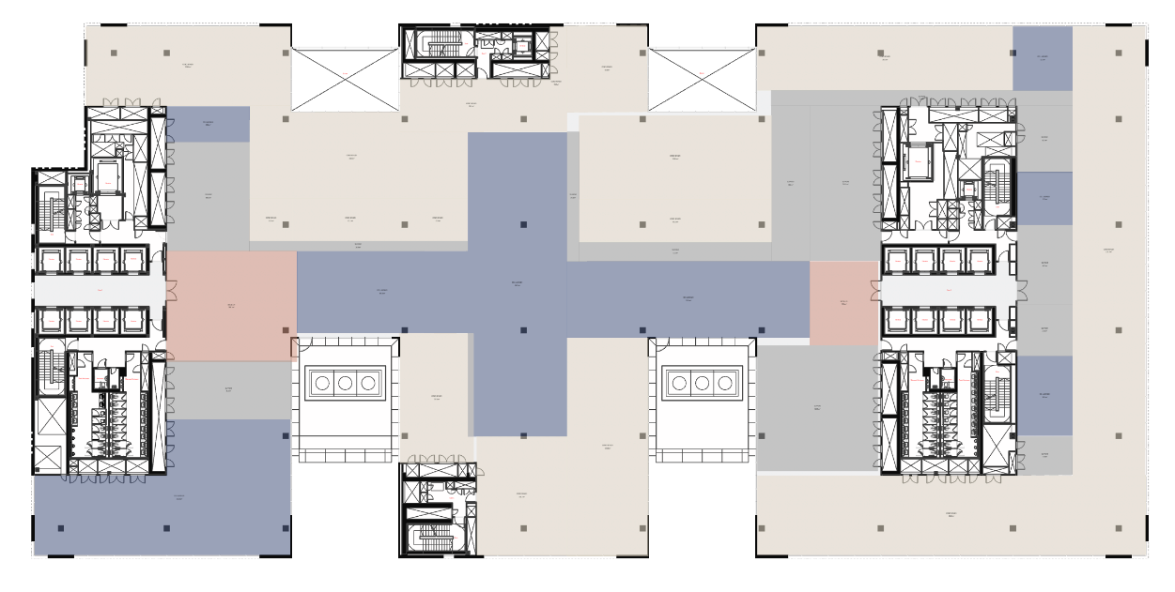
Link

Slide 38
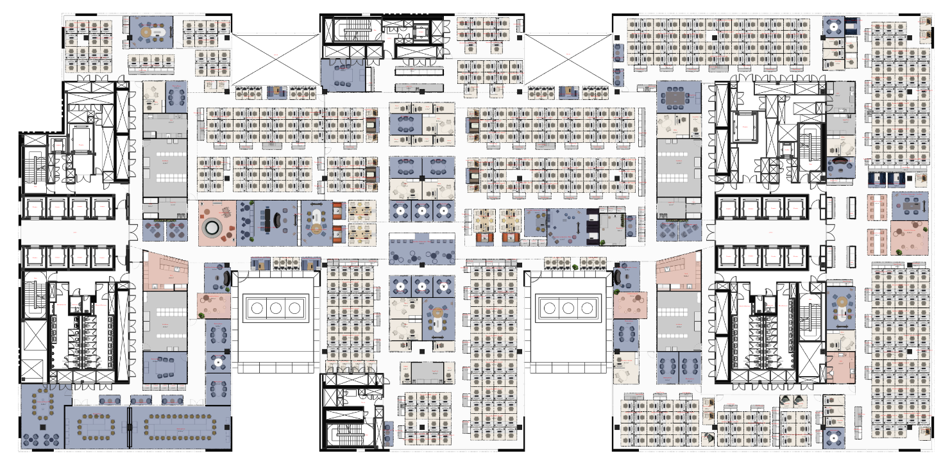
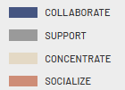
Customer 3

